Slide 1


Pre-Student Teaching an overview for the cooperating teacher
©copyright 2021 Educate-WI; All rights reserved

Slide 2
your Pre-Student Teaching Lesson
Pre-student teachers will teach a lesson at each developmental level during the pre-student teaching placements.
The pre-student teaching lessons can be taught to small groups or large groups of pupils in classrooms if the classroom has been pre-approved by the Program Administrator through the placement process.

Slide 3

Pre-Student teaching requirements
Per PI 34.023 (1), students are required to pre-student teach in the subject areas and developmental levels they are seeking certification for, which will be a minimum of two pre-student teaching placements.
  Early Childhood (for Early Childhood Special Education certification only)
  Kindergarten – Grade 8 (for EACH certification area)
  Grades 9-12 (for EACH certification area)
Pre-Student Teaching requirements MUST be completed during the coursework portion of the program. (Fall or Spring semesters)
Students must demonstrate proficiency as evaluated by their cooperating teacher in EACH pre-student teaching placement before they can be eligible for Student Teaching.

Slide 4

Pre-student teaching Requirements
Each student shall have onsite supervised pre-student teaching clinical experiences which meet each of the following requirements:
Are developmental in scope and sequence.
Occur in a variety of school settings.
Include at least one evaluation based upon observations by the Cooperating Teacher for each developmental level in each subject area.
The evaluations will be kept as part of the student file required under s. PI.34016.
The pre-student teaching experiences are completed as assignments during the fall/spring semester, depending on when you start the program.
The student will need to complete the pre-student teaching before the end of the Educate-WI semester. This date will be different from when the school district semester ends. Assignment due dates will be listed on your Educate-WI dashboard. Plan accordingly.

Slide 5

Pre-student teaching Requirements
The student must be assigned a pre-student teaching cooperating teacher or team of pre-student teaching cooperating teachers.
The pre-student teaching experience must provide the the opportunity for the pre-student teacher to interact with and adapt instruction for students at each developmental level.
The student must demonstrate greater knowledge and understanding of the Wisconsin 10 Teacher Standards, Communication Skills, Human Relations and Professional Dispositions, Content Knowledge, and Pedagogical Knowledge as demonstrated by a proficiency rating on the supervisor performance evaluations.

Slide 6
Student responsibilities
The student will be required to:
  Observe the classroom for the purpose of gaining students’ prior knowledge.
  Collaborate with the pre-student teaching cooperating teacher to develop a lesson plan using the Educate-WI Pre-Student Teaching Template.
  After teaching the lesson and conferencing with your Cooperating Teacher, use the Pre-Student Teaching Template to complete a self-evaluation and reflection which includes the adjustments that could be made to improve your score on each of the 10 Teacher Standards.
  Upload the Pre-Student Teaching Template for the pre-student teaching assignment.

Slide 7
Pre-Student Teaching Process
The student will select their preferred district(s) for the pre-student teaching placements.
The Educate-WI Program Administrator will contact the district to determine if there are teachers who can serve in the pre-student teaching cooperating teacher role and determine the schedule for each placement.
The student will report to each placement and observe, collaborate, plan, teach a lesson, and assess student learning during the placement.
The cooperating teacher will observe and evaluate the pre-student teacher using the Pre-Student Teaching Evaluation Rubric (A link to the evaluation will be included in the cooperating teacher welcome email. Please add info@educate-wi.com to your contact list.)
The cooperating teacher will conference with the pre-student teacher after the lesson, to go through the evaluation and offer suggestions on improvement.
The student will complete and upload the Pre-Student Teaching Template as an assignment during the fall/spring semester.
The student will also be evaluated by their course instructor on the submission of the Pre-Student Teaching assignment based on the pre-student teaching assignment rubric. The student will repeat this process for the second, and if appropriate, third placement.

Slide 8
Educate-wi student
(Pre-student teacher)
Pre-Student Teaching, Part 1:
1. Observes the class
2. Create a lesson plan
3. Teach the lesson
4. Cooperating Teacher observes and evaluates pre-student teacher while s/he teaches the lesson.
5. Cooperating Teacher conferences with the pre-student teacher
Note: Student must score a 2 or better on each of the 10 Wisconsin Teacher Standards to pass.
6. Fill out the Pre-Student Teaching Template
7. Turn in as the assignment
8. Instructor will grade the assignment
Note: Student must score a 3 or better on the assignment to pass.
Pre-Student Teaching, Part 2:

Slide 9
Evaluation of Proficiency in the Pre-student teaching placement
The pre-student teacher must demonstrate proficiency by obtaining a score of a 2 or better on each of the 10 WI Teacher Standards as evaluated by the pre-student teaching cooperating teacher.
A minimum of one observation and evaluation must be completed by the cooperating teacher in the certification area for each developmental level in which the pre-student teacher is seeking certification.
The cooperating teacher will conference with the pre-student teacher after the lesson, to go through the evaluation and offer suggestions on improvement.
More than one evaluation at each developmental level may be required if the student is unable to demonstrate proficiency. (Demonstrate proficiency while pre-student teaching by scoring a 2 or better on each of the10 Wisconsin Teacher Standards.)
In addition to the cooperating teacher’s observation/evaluation, the student will turn in the Pre-Student Teaching Template as an assignment during the fall/spring semester for the instructor to grade. Students must receive a score of 3 or better on the assignment in order to pass the course.

Slide 10
COOPERATING TEACHER
ROLE & EXPECTATIONS

Slide 11
Pre-Student Teaching Cooperating Teacher Requirements
Holds a valid WI teaching license, or an equivalent license if the clinical program is located outside of Wisconsin, must have a minimum of three years successful teaching experience including one year of teaching experience at district of placement.
Must have volunteered for the placement and have it approved by a building administrator.
Knowledgeable of subject matter and able to model effective pedagogy.

Slide 12

Pre-Student Teaching cooperating teacher Responsibilities
The pre-student teaching cooperating teacher will receive a Welcome Email from Educate-WI that includes the pre-student teacher’s name and email address. Please reach out to the student to schedule a time that works for you to have the pre-student teacher observe your class and begin the pre-student teaching process. The email also includes a link to submit the pre-student teacher evaluation scores online. (Please add info@educate-wi.com to your contact list to avoid this important email going to junk/spam.)
Review the Pre-Student Teaching Evaluation Rubric prior to the student teaching the lesson,
Allow the student to observe your classroom and get to know the students.
Describe your objectives for the lesson that will be taught during the pre-student teaching experience.
Collaborate with your pre-student teacher and provide feedback on the lesson plan, including behavior management strategies BEFORE the pre-student teacher teaches the lesson.
Conference with the student after the evaluation to discuss your rating and suggest strategies for improvement.
Prior to entering scores online, you will need to create an Educate-WI account.
      Educate-WI.com >> My Account >> Create an Account
      Once you’ve created an account, go back to the email, click the evaluation link to enter scores.

Slide 13
Pre-Student Teaching cooperating teacher Responsibilities
Evaluate the student’s proficiency on the 10 Wisconsin Teacher Standards using the Pre-Student Teaching Evaluation Rubric.
Conference with the student after the evaluation to discuss your rating and suggest strategies for improvement.
A score of 2 or higher on each standard is required to demonstrate proficiency.

Slide 14
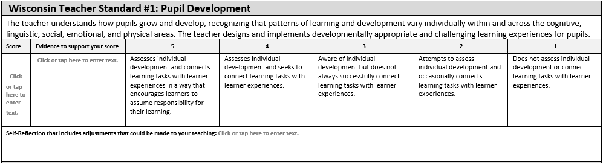
Standard #1:
Pupil DEVELOPMENT
A score of 2 or higher on each standard is required to demonstrate proficiency.

Slide 15
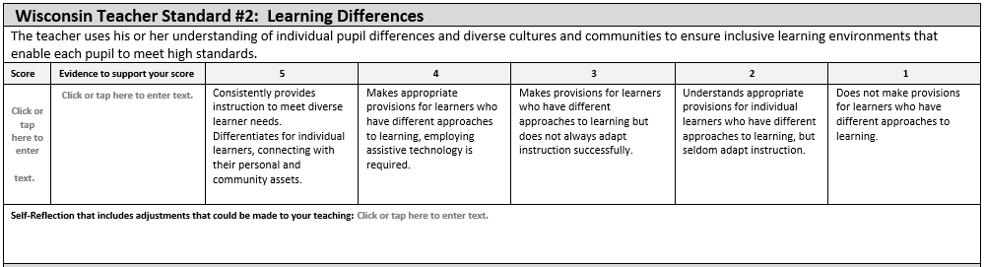
Standard #2:
LEARNING DIFFERENCES
A score of 2 or higher on each standard is required to demonstrate proficiency.

Slide 16
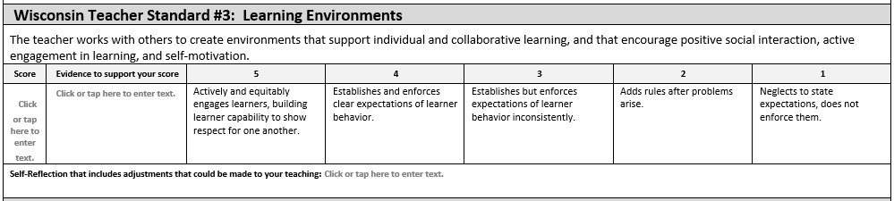
Standard #3:
LEARNING environments
A score of 2 or higher on each standard is required to demonstrate proficiency.

Slide 17
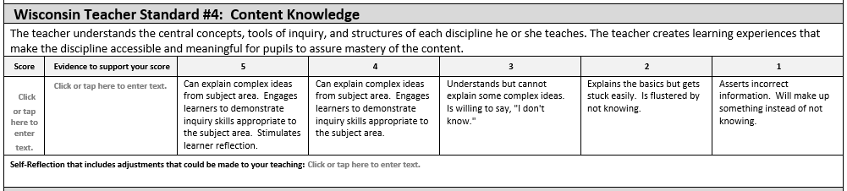
Standard #4: content knowledge
A score of 2 or higher on each standard is required to demonstrate proficiency.

Slide 18
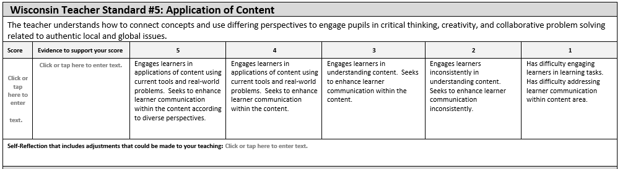
Standard #5: application of content
A score of 2 or higher on each standard is required to demonstrate proficiency.

Slide 19
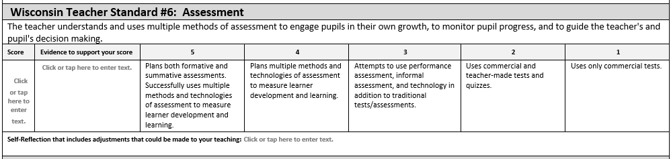
Standard # 6: ASSESSMENT
A score of 2 or higher on each standard is required to demonstrate proficiency.

Slide 20
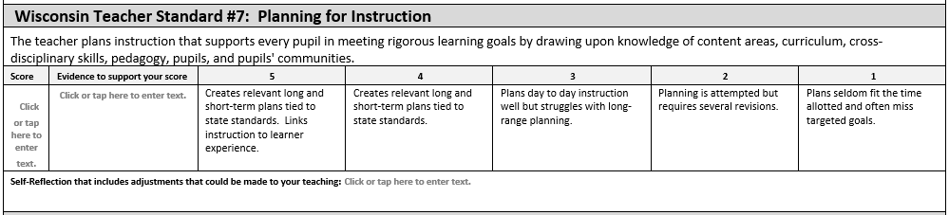
Standard #7: planning for instruction
A score of 2 or higher on each standard is required to demonstrate proficiency.

Slide 21
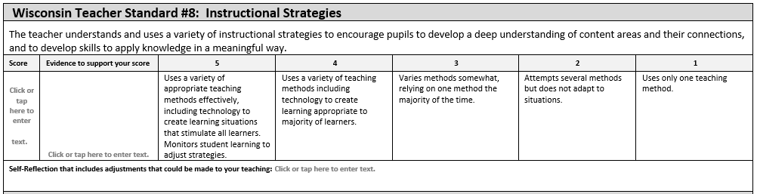
Standard #8: instructional strategies
A score of 2 or higher on each standard is required to demonstrate proficiency.

Slide 22
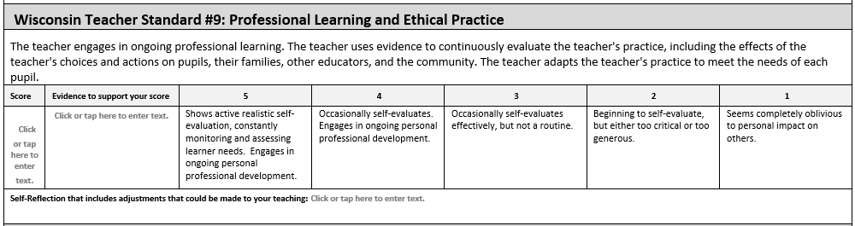
Standard #9:
Professional learning and ethical practice
A score of 2 or higher on each standard is required to demonstrate proficiency.

Slide 23
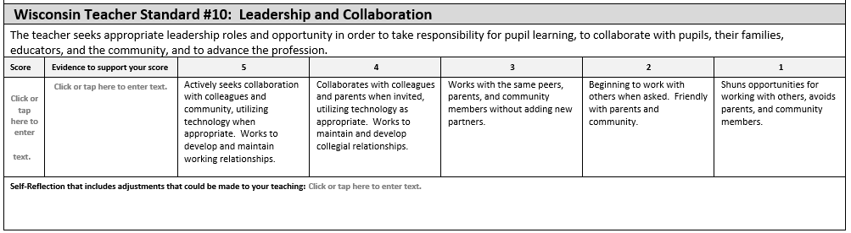
Standard #10: leadership and collaboration
A score of 2 or higher on each standard is required to demonstrate proficiency.

Slide 24
Cooperating teacher responsibilities
Your role is key in mentoring and providing guidance to developing pre-student teachers.
Collaborate
Collaborate with the pre-student teacher in a way that allows the student to grow and develop skills and dispositions necessary for teaching.
Collaborate with your pre-student teacher and provide feedback on the lesson plan, including behavior management strategies BEFORE the pre-student teacher teaches the lesson.
Evaluate
Evaluate pre-student teacher’s proficiency as a pre-student teacher based on the ten teacher standards. An email which includes a link to the evaluation will be sent at the beginning of the semester.
Conference
Conference with the student after the evaluation to discuss your rating and suggest strategies for improvement.
Communicate
Communicate with the Educate-WI supervisor, instructor and/or program administrator at the first sign of challenges. If the student is hired on a Tier I license with stipulations, the immediate supervisor (typically the principal or director of special education and pupil services) should also be included in the communications.

Slide 25
What happens If the student does not demonstrate proficiency?
The cooperating teacher will consult with the student to provide personalized recommendations for improvement.
The student will again collaborate with the cooperating teacher to develop a new lesson plan and teach the lesson.
The student will need to redo and reteach the lesson until achieving a score of 2 or better on the 10 Wisconsin Teacher Standards as evaluated by the cooperating teacher and a 3 or better on the assignment (as scored by the Educate-WI instructor).
The student teaching placement of the program may be delayed until the student is able to demonstrate proficiency during the pre-student teaching placements.

Slide 26
Summary of Pre-Student Teaching
Each student is required to have onsite, supervised pre-student teaching clinical experiences at the developmental levels they will be certified in before the student teaching semester.
The student will select their preferred district(s) for the pre-student teaching placements.
The Educate-WI Program Administrator will contact the district to find qualified cooperating teachers who can serve as the pre-student teacher’s cooperating teachers.
The student will collaborate with the cooperating teachers to plan, instruct, and assess student learning in each placement. (Lesson plan must be approved by the cooperating teacher.)
The cooperating teacher will observe and evaluate the pre-student teacher’s proficiency by using the Pre-Student Teaching Evaluation Rubric.
The cooperating teacher will conference with the pre-student teacher after the lesson, to go through the evaluation and offer suggestions on improvement.
The cooperating teacher will receive a Welcome Email from Educate-WI that includes a link to submit the pre-student teacher evaluation scores online. (Please add info@educate-wi.com to your contact list.)
The student will self-evaluate using the Pre-Student Teaching Template and write a reflection for each standard which includes adjustments that could be made to improve the score on each standard,
The student will upload the Pre-Student Teaching Template for their Pre-Student Teaching assignment.
The pre-student teacher must demonstrate proficiency of the 10 Wisconsin Teacher Standards (score of 2 or better on each standard) to be eligible for student teaching.
The Educate-WI Instructor will score the assignment using the Pre-Student Teaching Assignment Rubric. Passing is a score of 3 or better on the assignment. If the student does not score a 3 or better, s/he will need to redo and resubmit the pre-student teaching assignment. It is possible for the student to receive 2’s on the Pre-Student Teaching Evaluation and a 3, 4, or 5 on the assignment rubric.
The student will need to complete the pre-student teaching before the end of the Educate-WI semester. This date will be different from when the school district semester ends. Assignment due dates are listed on your Educate-WI dashboard. Please plan accordingly.

Slide 27
student and cooperating Teacher support
The Instructor will be available to support the student teacher and cooperating teacher as needed throughout the pre-student teaching experience.
The Program Administrator is available to answer any questions regarding the pre-student teaching placement and general requirements.
Educate-WI Instructor
Program Administrator
The Program Director will provide direct support to the team if the student is not demonstrating proficiency.
Program Director

Slide 28

Questions?
Please contact:
10 sped & Project teaching program administrator
Tricia@educate-wi.com educate-wI office (715) 246.6555
©copyright 2021 Educate; All rights reserved

