Slide 1

Student Teaching Module

Slide 2

Why must I student teach?
Where will I student teach?
When will I student teach?
What will the student teaching semester look like?
Who is involved in the student teaching semester?

Slide 3
Why must I student teach?
Candidates who have successfully completed the program coursework must complete student teaching. If you are currently teaching fulltime under a 1-Year License with Stipulations, you will be evaluated as a student teacher.
Students seeking an initial certification
Students seeking an additional certification
must student teach full days for a full semester (Wis. Stats. 118.19(3)(a)).
will complete their student teaching within a 9-week timeframe.

Slide 4
Where will I student teach?
Per PI 34.023 (1), students are required to student teach in the subject area and developmental level in which they are seeking certification.
10 Sped:
-Early Childhood Special Education (birth-3rd grade)
-Cross Categorial Special Education (K-12)
Project Teaching
-Subject area and grade level you are seeking.
If you are working on a 1-year license with stipulations in the subject area and age level you are getting certified in, student teaching can be set up on the job.
If you are not working on a 1-year license with stipulations, you will have the opportunity to request placement in specific districts. Your program administrator will contact the school district(s) and request placement. (Students do not set up their own student teaching placement.)

Slide 5

When will I student teach?
Student teaching is the final semester of the program
  10 Sped: Semester IV (EDWN 612)
  Project Teaching: Semester III (EDWN 612)
In order to be eligible to student teach:
The student must have completed and passed all required coursework.
  10 Sped Students:
  EDWN 605, EDWN 606, EDWN 608
  Project Teaching Students:
  EDWN 600, EDWN 603
2. The student must have passed all pre-student teaching requirements.

Slide 6

What will the student teaching semester look like?
Student Teaching Requirements:
The student must be assigned a cooperating teacher or team of cooperating teachers.
The student teaching experiences must be developmental in scope and sequence, occur in school settings, and meet the statutory requirements identified in s. 118.19 (3)(a), Stats.
The student teaching experience must provide the student the opportunity to interact with and adapt instruction for students with disabilities.
Students must demonstrate greater knowledge and understanding of the Wisconsin 10 Teacher Standards, Communication Skills, Human Relations and Professional Dispositions, Content Knowledge, and Pedagogical Knowledge as demonstrated by a proficiency rating on the cooperating teacher and supervisor performance evaluations.

Slide 7

PI34 Evaluation Requirements
Student Teaching Evaluation Rubric based on the 10 Wisconsin Teacher Standards is provided by Educate-WI. Both the cooperating teacher and the Educate-WI supervisor will use the Student Teaching Evaluation Rubric to measure student proficiency on the 10 Wisconsin Teacher Standards.
For students seeking initial certification:
  The cooperating teacher will complete two evaluations and participate in three conferences with the student teacher and supervisor throughout the semester.
  The Supervisor will conduct three observations/evaluations and participate in three conferences with the student teacher and cooperating teacher throughout the semester.
For students seeking additional certification,
  The cooperating teacher will complete at least one evaluation and participate in one conference with the student teacher and supervisor.
  The Supervisor will complete at least one evaluation and participate in one conference with the student teacher and cooperating teacher.
  This could be one conference if both observations and evaluations are conducted at the same time.
  If the student does not demonstrate proficiency, additional evaluations will be required.

Slide 8
Student Teaching Evaluation Requirements
Initial certification seeking student:
Additional certification seeking student:
Initial certification seeking student teachers must student teach full days for a full semester (16 weeks) and follow the cooperating teacher’s schedule. .
The supervisor must complete three observations and evaluations in person or real time virtual. One observation and evaluation must be done in person.
The cooperating teacher must complete two observations and evaluations.
Evaluations should be scheduled at regular intervals throughout the semester to allow students to develop necessary skills.
The cooperating teacher, student teacher, and supervisor must conference after each evaluation (for a total of three times).
Additional certification seeking student teachers must demonstrate proficiency within a 9-week timeframe.
A minimum of one observation and evaluation must be completed by the cooperating teacher.
A minimum of one observation and evaluation must be completed by the supervisor.
The cooperating teacher, student teacher, and supervisor must conference after each evaluation (could be one conference if both observations and evaluations are conducted at the same time).
If the student does not demonstrate proficiency, additional evaluations will be required.

Slide 9

Student Teacher Responsibilities
  Keep the contractual schedules/hours/days of their cooperating teachers and be on time
  Assume all the contractual responsibilities and expectations the school/district has of their teachers
  Assume this responsibility in a gradual sequence with opportunities to observe and learn from cooperating teachers
  Spend the time necessary outside of school to prepare for student teaching responsibilities
  Demonstrate disposition for teacher (both professionally and ethically)
  Dress professionally according to the dress codes of the school
  Ascertain permission from their cooperating teachers for all the activities they do on the school site
  Provide lesson plan to cooperating teacher and Educate-WI Supervisor prior to each observation.
  Be observed in their assigned classrooms by cooperating teacher and Educate-WI supervisor, to participate in conferences where they will receive feedback from cooperating teacher and supervisor, and to participate in the performance evaluation process.
  Follow directions given in writing or orally from the cooperating teacher and Educate-WI supervisor. Ask questions for clarification and/or for any help they need with placement assignments, course assignments, etc.
  Keep in mind that you are a guest in the classroom.
  Please remember that the Cooperating Teacher you are with, volunteered to have you in their classroom.
  The student teacher is not able to make changes to the classroom environment, curriculum, or the behavior management plan without the consent of the Cooperating Teacher.

Slide 10
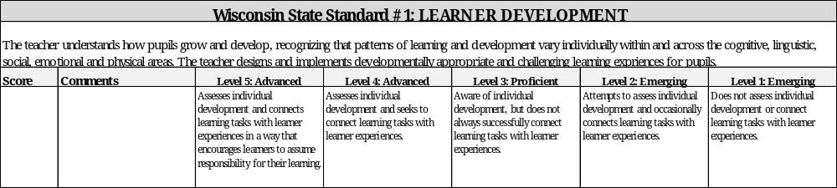
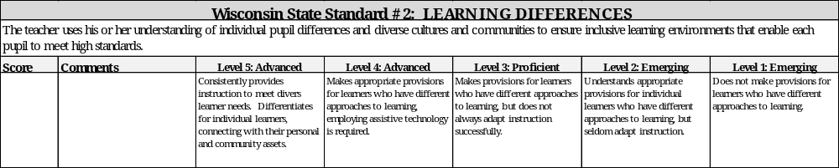
Both the cooperating teacher and the Educate-WI supervisor will use the Student Teaching Practicum Evaluation Rubric to measure student proficiency on the 10 Wisconsin Teacher Standards.
Student Teaching Practicum Evaluation Rubric

Slide 11
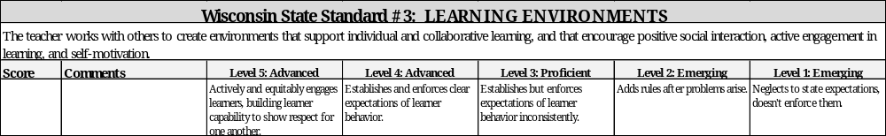
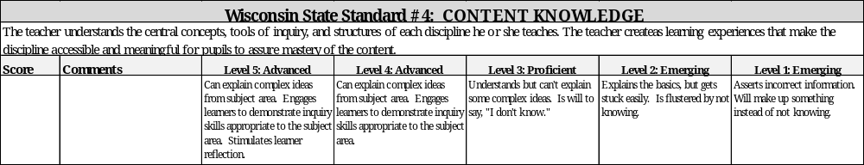
Student Teaching Practicum Evaluation Rubric cont.

Slide 12
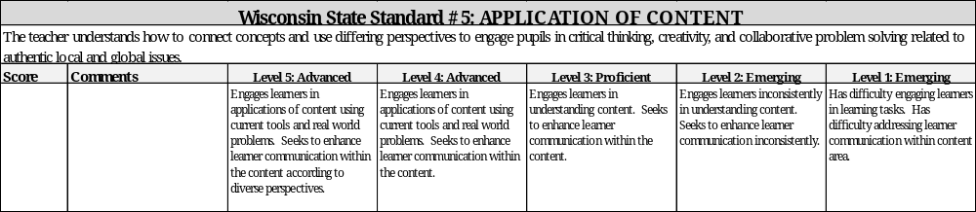
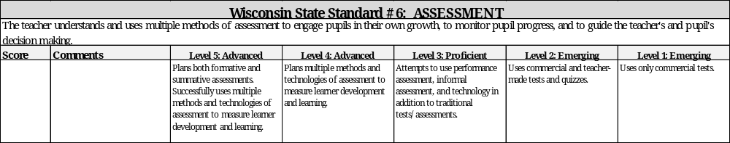
Student Teaching Practicum Evaluation Rubric cont.

Slide 13
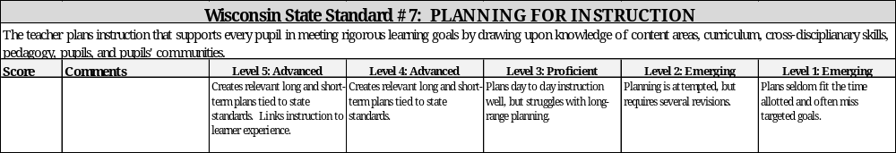
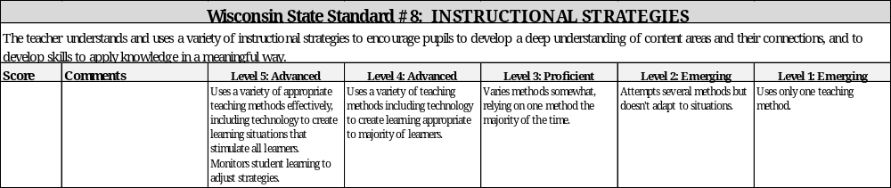
Student Teaching Practicum Evaluation Rubric cont.

Slide 14
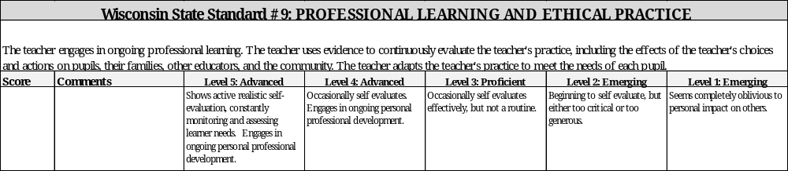
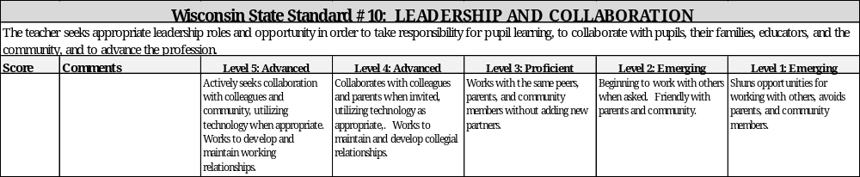
Student Teaching Practicum Evaluation Rubric cont.

Slide 15
Student Teacher
The student teacher has the support of the Educate-WI Supervisor, Educate-WI Instructor/Advisor, Cooperating Teacher, and Program Administrator.
Educate-WI Supervisor
The Educate-WI Supervisor will schedule observations, conduct evaluations and conference with the student teacher and cooperating teacher.
Cooperating Teacher
The Cooperating Teacher will schedule observations, conduct evaluations and conference with the student teacher and Educate-WI Supervisor
Educate-WI Instructor/Advisor
The program administrator is available to answer any questions regarding the student teaching placement and general requirements.
The instructor/advisor will be available to support the student teacher, cooperating teacher and supervisor as needed throughout the student teaching semester.
Program Administrator
Who is involved and what are their roles?

Slide 16
Cooperating Teacher
The cooperating teacher is key in mentoring and providing guidance.
The cooperating teacher will be directly responsible for assessing the student teacher’s gradual progression to full time teaching.
The qualifications for a cooperating teacher include:
  A valid Wisconsin license, or an equivalent license if the clinical program is located outside of Wisconsin.
  Volunteered for the student teacher placement.
  At least 3 years of teaching experience in the certification subject area.
  At least 1 year of experience in your current district.
  Complete the Educate-WI Cooperating Teacher Modules I and II. https://www.educate-wi.com/content/programs/10sped/cooperating-teachers

Slide 17
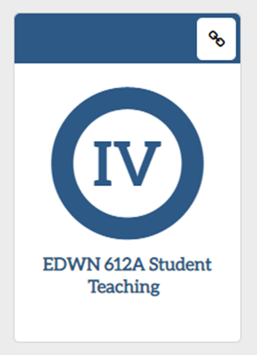
Student Teaching & the Educate-WI Dashboard

Slide 18
You will see a notification through your student dashboard once your Program Administrator has started your student teaching process.
Setting up your student teaching on the Educate-WI student dashboard.
When you click the notification, you’ll be directed to your student teaching information page.
You’ll need to confirm your planned student teaching semester.
If the semester listed is incorrect, please contact the program administrator.

Slide 19
If you are teaching on a 1-year license with stipulations in the area you are in which you are seeking certification, you can student teach “on the job”.
You’ll need to provide your employment supervisor’s name & email address.
You’ll need to list the school district in which you’re currently teaching.
Under NOTES please list the school at which you’re teaching in the district and the grade(s) you are teaching.
The program administrator will contact your supervisor and set up the placement.

Slide 20
You’ll need to provide your 1st, 2nd, and 3rd school district preference for your student teaching placement.
If you are not teaching on a 1-year license with stipulations
If you start typing in the “search by district name” line, the system should recognize the district and allow you to choose it. (Please save your selections!)
Under NOTES please list any specific school and/or grade preference. The more information we have, the easier it is to request placement for you.
The program administrator will contact the district(s) to set up your placement.

Slide 21
Memorandum Of Understanding:
You will need to download the form, collect the necessary signatures, and then upload the signed form.
Once your placement is confirmed, you will need to sign & upload the following to the Educate-WI student profile.
Liability Insurance Verification:
You can purchase a student membership to the National Education Association (NEA). Go to http://www.nea.org/ and choose “Join NEA”, choose student membership for WI. Make sure membership is for the months you’ll be student teaching.
Student Teaching/Practicum Agreement:
You will need to sign & accept this agreement.
Background Check
You will need to submit a second background check for the student teaching semester.

Slide 22

Number of Evaluations during Student Teaching
Initial certification seeking students:
  Educate-WI Supervisor – 3
  Cooperating Teacher – 2
Additional certification seeking students:
  Educate-WI Supervisor – 1
  Cooperating Teacher – 1
  (Additional observations/evaluations may be required if the student teacher does not demonstrate proficiency in the 10 teacher standards during initial observation.)

Slide 23
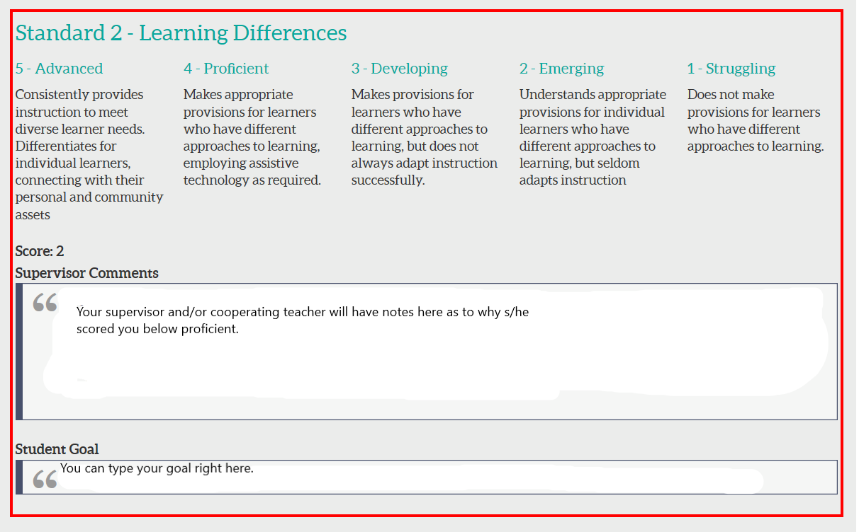
When your Educate-WI Supervisor and/or Cooperating Teacher submit an evaluation, you will receive a notification on your dashboard.
If you click on the notification, it will direct you to the evaluation.
If you see any standards that were scored as not proficient (scored below a 3), you’ll need to set a goal for the standard(s). These standards will be outlined in red.

Slide 24
What is required to pass student teaching?
Student seeking initial teacher certification:
Obtain a minimum of 3 points on each standard per the two evaluations from the cooperating teacher.
AND
Obtain a minimum of 3 points on each standard per the three evaluations from the Educate-WI supervisor.
Student seeking additional teacher certification:
Obtain a minimum of 3 points on each standard per the evaluation from the cooperating teacher.
AND
Obtain a minimum of 3 points on each standard per the evaluations from the Educate-WI supervisor.
NOTE: If the student does not pass initial evaluation, additional evaluation(s) will be required within the 9-week timeframe.

Slide 25

Questions?
Please contact:
10 Sped
Natalie@educate-wi.com
Project Teaching
Tricia@educate-wi.com
Educate-WI office (715) 246.6555

